Slide 1

COS 301
TEAM ANDROID - BRAVO

Slide 2
WHY ANDROID STUDIO?
Supports Gradle
Code Completion
User Interface
Drag-and-drop Interface

Slide 3
GRADLE
Build Tool used by Android Studio
Flexible and offers the best of Ant and Maven
Automated script when code is run
Creates a script for all modules in one file
Script can be changed as desired

Slide 4
GRADLE
Gradle built script for our Mock Interface
Specify type of application to build: “apply plugin: 'com.android.application‘”
This build script is divided into two parts:
Dependencies:
Other third party applications used for functionality
Ivy and Maven dependency and repository compatibility layer
Simple and flexible specification
Android:
It contains the fields “compileSdkVersion” and “buildToolsVersion”
It also contains the “defaultConfig” and “buildTypes” subsections.

Slide 5
GRADLE
defaultConfig Contents and Syntax:
defaultConfig {
applicationId "com.slugger7.upresearch"
minSdkVersion 16
targetSdkVersion 23
versionCode 1
versionName "1.0"
}

Slide 6
GRADLE
buildTypes Contents and Syntax:
buildTypes {
release {
minifyEnabled false
proguardFiles getDefaultProguardFile('proguard-android.txt'), 'proguard-rules.pro'
}
}

Slide 7
GRADLE
Dependencies:
dependencies {
compile fileTree(dir: 'libs', include: ['*.jar'])
testCompile 'junit:junit:4.12'
compile 'com.android.support:appcompat-v7:23.2.1'
compile 'com.android.support:design:23.2.1'
}

Slide 8
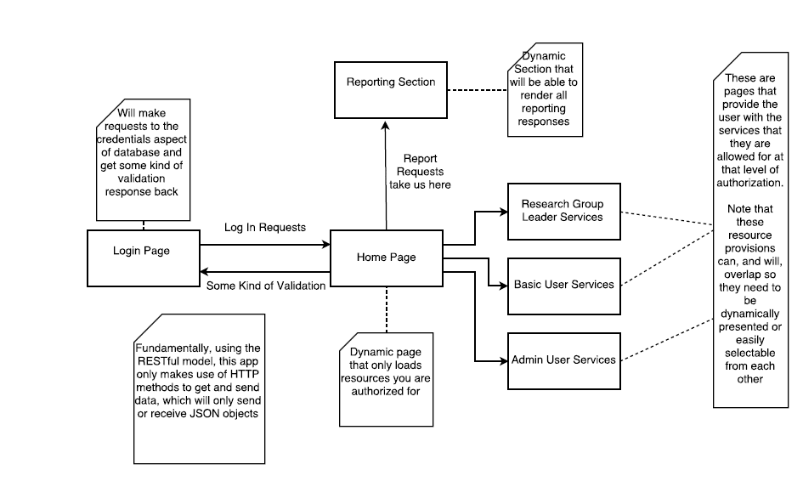
INTERFACE DESIGN FOR UP RESEARCH

Slide 9
INTERFACE DESIGN FOR UP RESEARCH
The homepage will be dynamically created for each user
Contents of the homepage will be papers in progress
On the homepage, there will be a sliding global menu
The menu will contain the following fields:
Basic User: Profile, Publication, Report, Search, Logout
Head of Research: an additional privileges field for such a user will be added
Admin: an additional privilege field named “Admin” will be added

Slide 10
INTERFACE DESIGN FOR UP RESEARCH
There will only be one global menu
This menu will be on the homepage
Each item on the menu will have a submenu
The submenu is depicted by three dots
These three dots will contain actions/subfields belonging to that item
These items on the submenu will then dynamically create a page
This page will display items related to that particular action

Slide 11
PROFILE
Each sub item selected will generate a page
The Profile dot menu will contain the following functions:
View/Edit Profile

Slide 12
PUBLICATION
The Publication dot menu will contain the following actions:
Add/Edit publications

Slide 13
REPORT

Slide 14
SEARCH

Slide 15
HEAD OF RESEARCH

Slide 16
ADMIN

Slide 17
LOGOUT
This option will redirect the user to the login page

Slide 18
TECHNICAL CHALLENGES
These challenges include:
Session Management
Appropriate API for graphical Reporting Subsystem statistics generation
Password reset options
Update installations
Maintain history of activity for each user
Android API version should be selected to balance user reachability and functionality
Handling every possible exception thrown elegantly, i.e. to avoid the program to crash
Handling unreliable connections
Importing/Exporting CSV files

